Slide 1
Diversity, Equity, and Inclusion
Unintentional Bias in the Workplace, Embracing Diversity and Understanding Bias
DIAZ DIXON, MA
Performance Driven Consulting
SVP, CommonSpirit Health

Slide 2
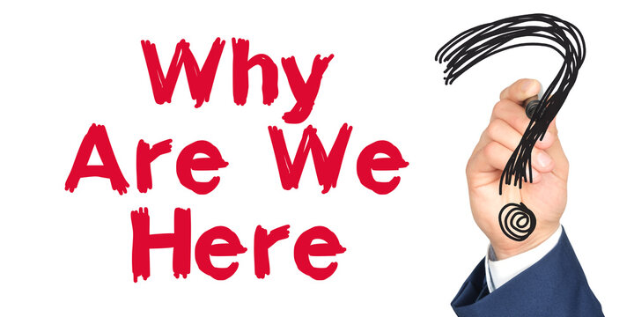

Slide 3
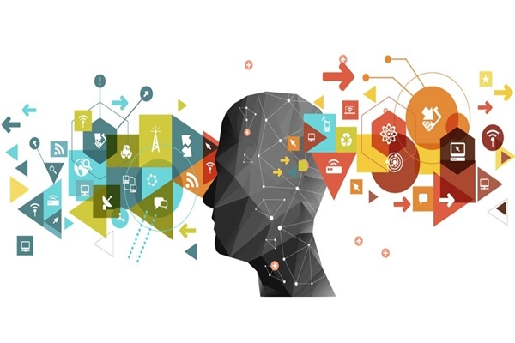
Learning is a journey… NOT A CURE

Slide 4
We keep finding ourselves here because of our approach
70%
On the Job Experiences
20%
Informal Learning
10%
Formal
Learning

Slide 5
DIVE IN TO YOUR TEAM
Development of staff and leaders.
Invest in staff and the processes that surround them.
Value the differences each person brings to the team.
Evaluate who you are as an organization.

Slide 6
Implicit Bias
Cause us to have feelings and attitudes about other people based on characteristics such as race, ethnicity, age, and appearance.
“The attitudes or stereotypes that affect our understanding, actions, and decisions in an unconscious manner.”
Develop over the course of a lifetime through exposure to direct and indirect messages.

Slide 7
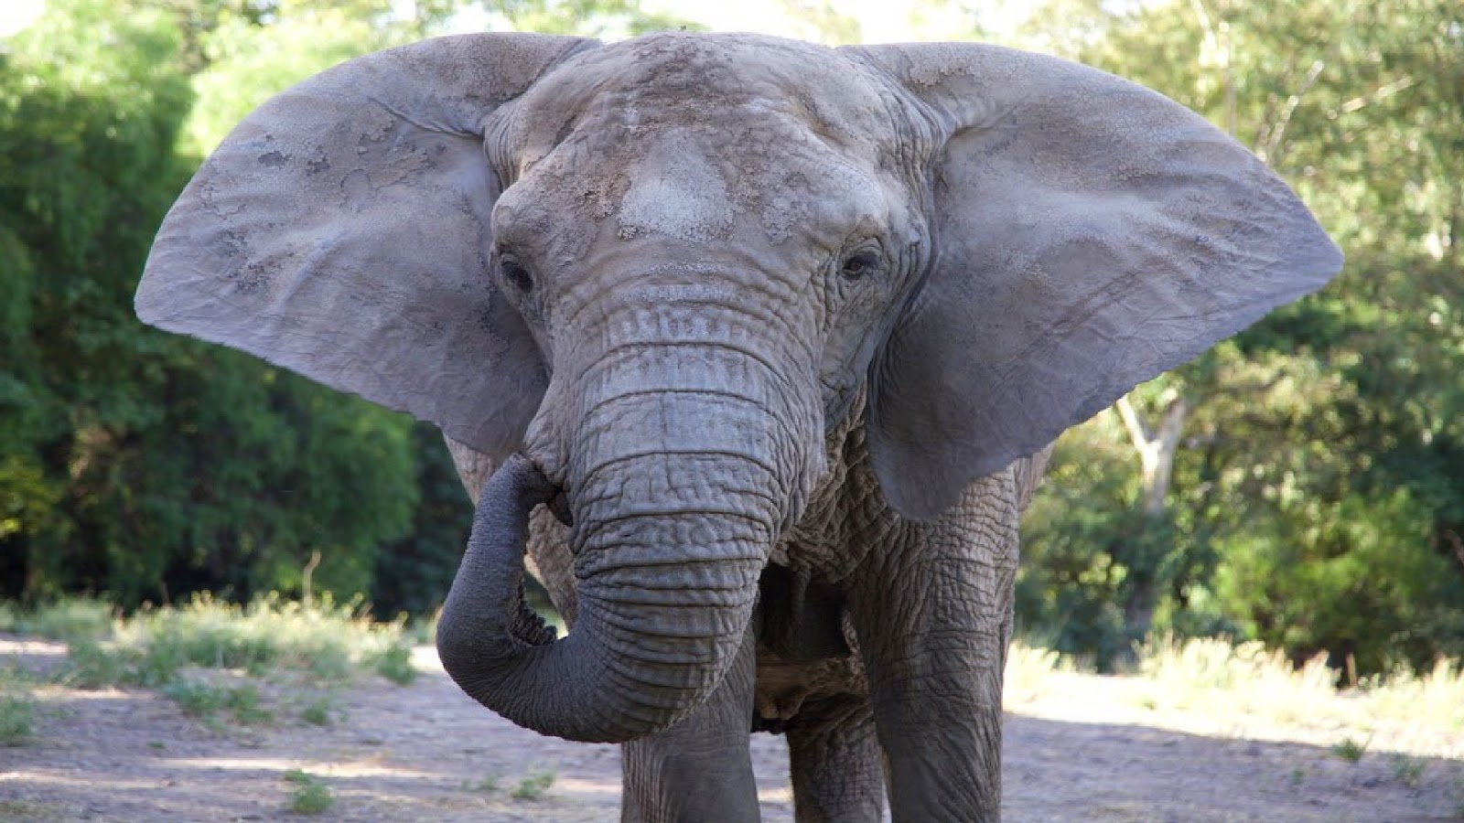

Slide 8
“We are either unaware of, or mistaken about, the source of our thoughts or feelings.” (Zajonc, 1980)

Slide 9
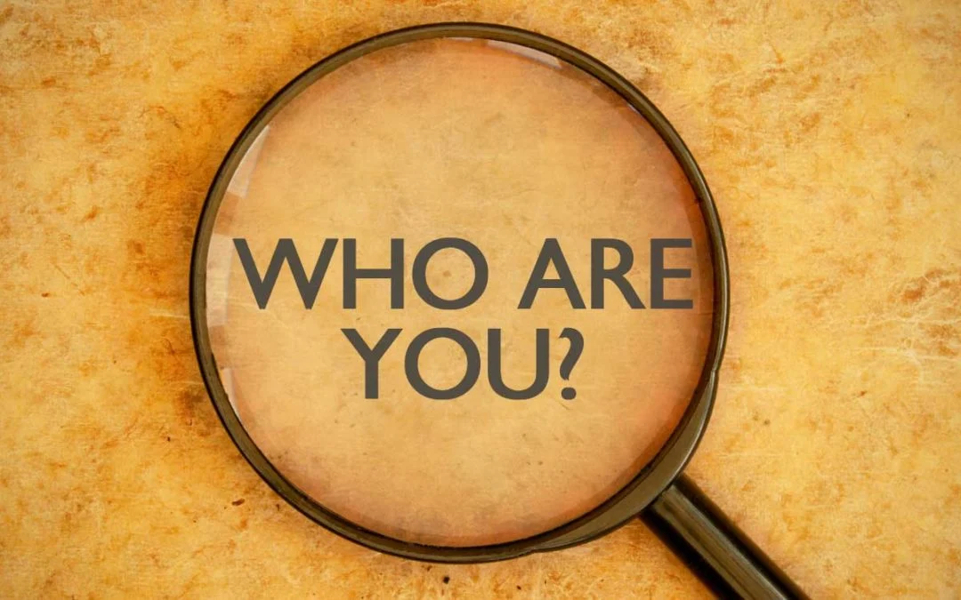

Slide 10
What is Diversity?
Diversity is defined as all characteristics and experiences that define each of us as individuals.
A common misconception about diversity is that it only pertains to certain persons or groups, when in fact, exactly the opposite is true.
Diversity can include Race, Ethnicity, Gender, Age, Religion, Disability, and Sexual Orientation.
A diverse workplace aims to create an inclusive culture that values and uses the talents of all its employees.

Slide 11
What is Inclusion?
Differences and similarities in perspectives, identities and points of view
Inclusion
Diversity
Belonging
A sense of connection to others that is always in the process of being actively achieved

Slide 12
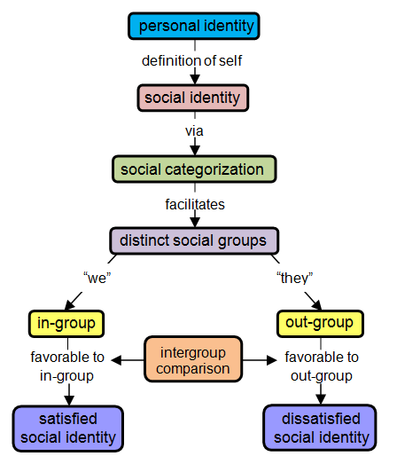
Where it all begins…

Slide 13
Unpacking our beliefs

Slide 14
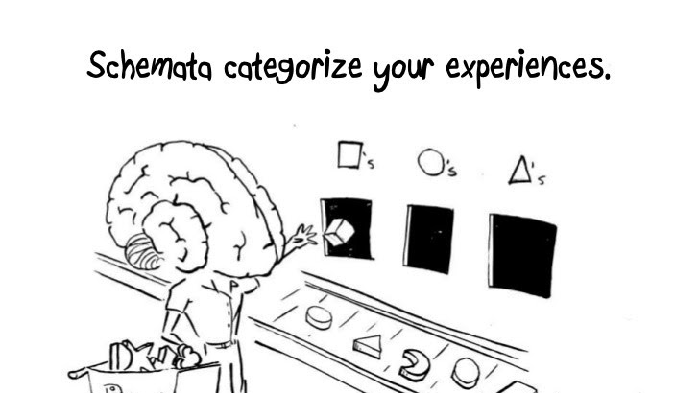

Slide 15
What is Equity?
Equality vs. Equity. The difference between equality and equity must be emphasized. Although both promote fairness, equality achieves this through treating everyone the same regardless of need, while equity achieves this through treating people differently depending on need.

Slide 16
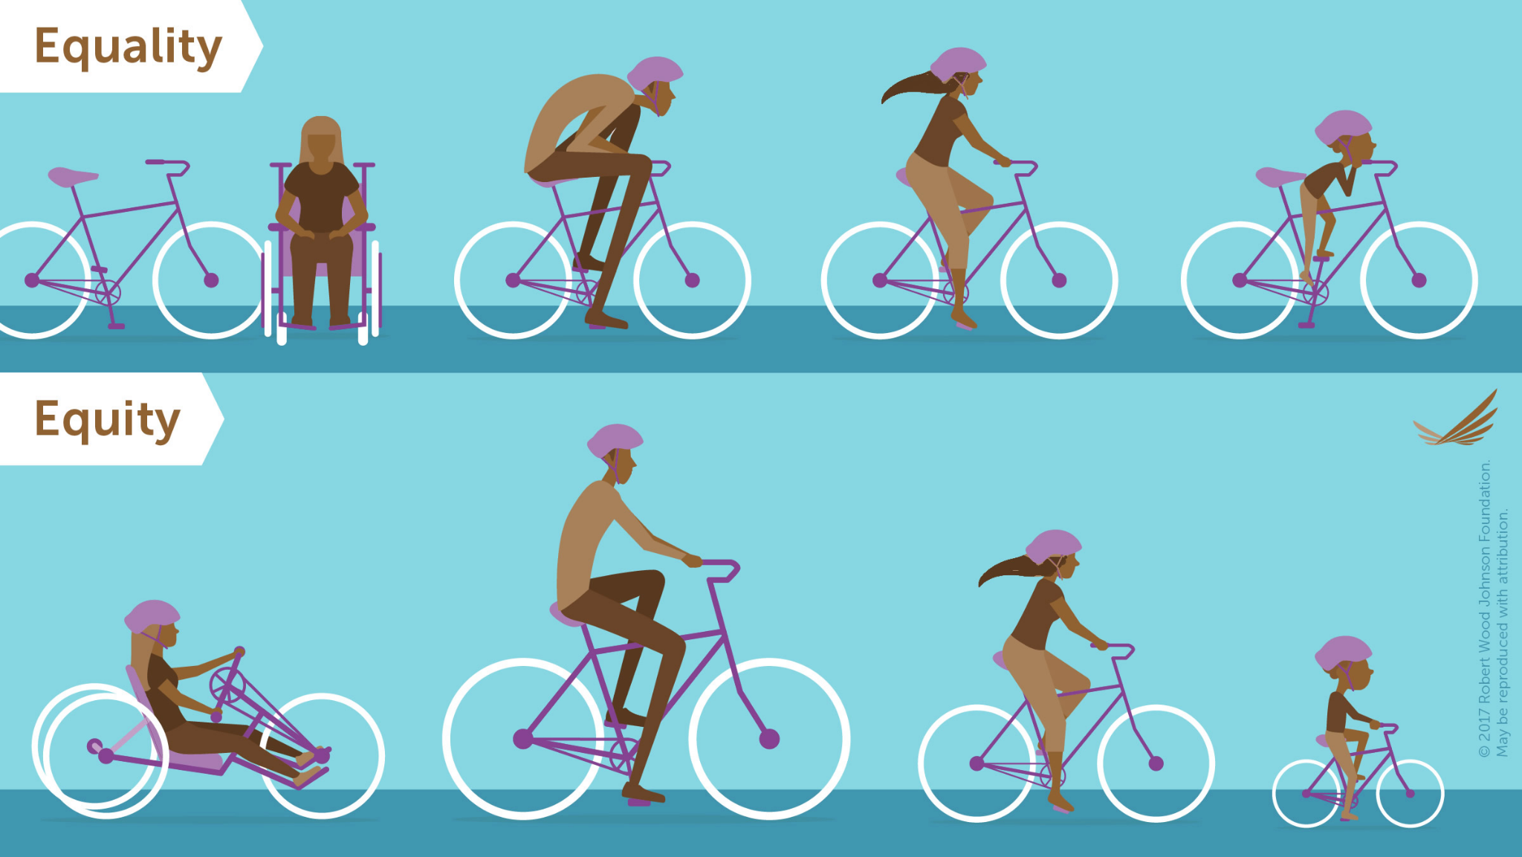

Slide 17
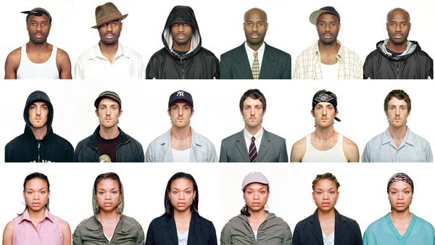

Slide 19
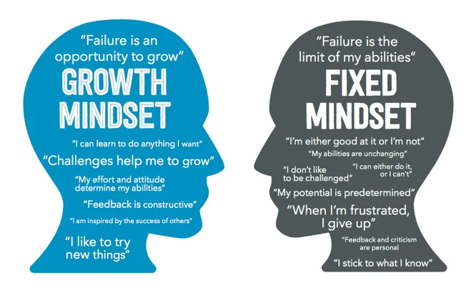
Accepting the challenges with a growth mindset

Slide 20
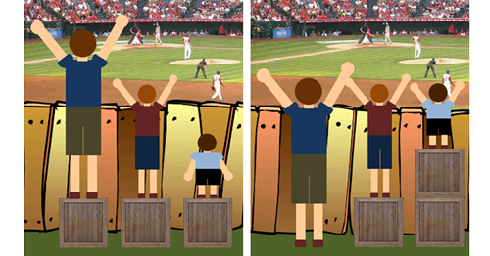

Slide 22
The Shadow Tree

Slide 23
Implicit Bias
Implicit Bias – (n.) Refers to the attitudes or stereotypes that affect our understanding, actions and decisions in an unconscious manner. Rather, implicit biases are not accessible through introspection.

Slide 24
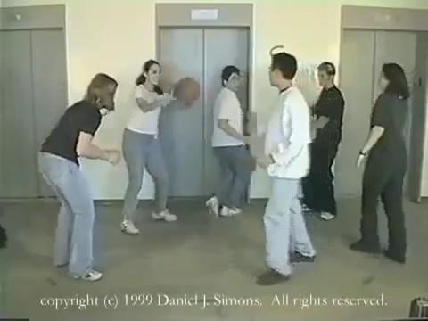

Slide 26
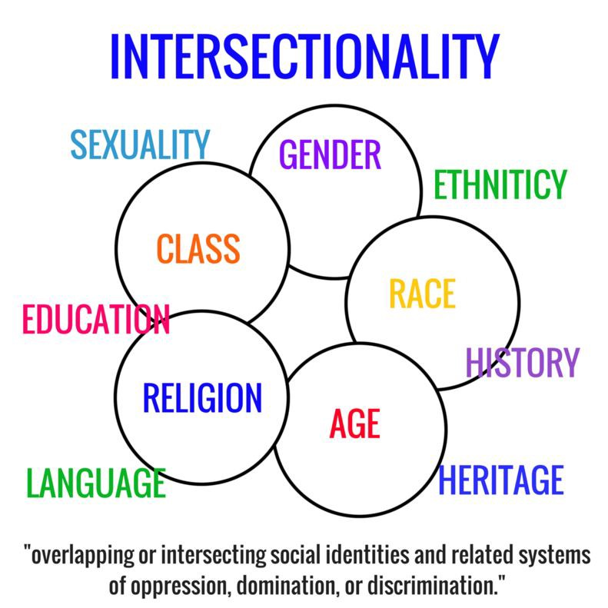
Intersectionality

Slide 27
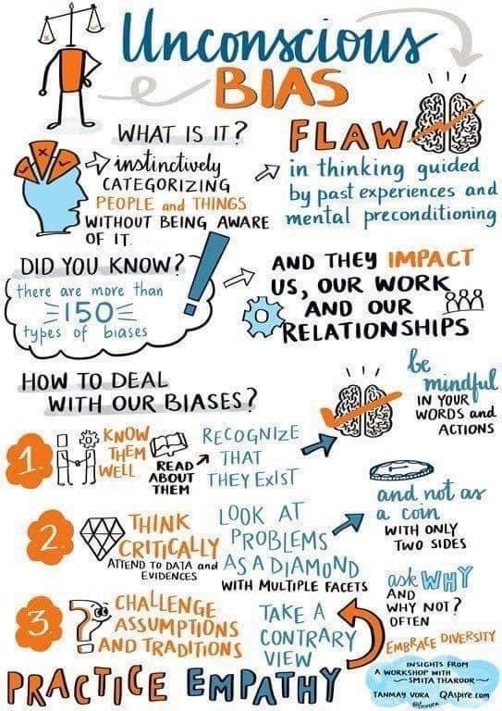
Unconscious Bias

Slide 28
Inclusivity Benefits ALL…
Increased community satisfaction
Lower work turnover
Higher productivity
Improved creativity and innovation
Improved problem solving
Increased flexibility

Slide 29
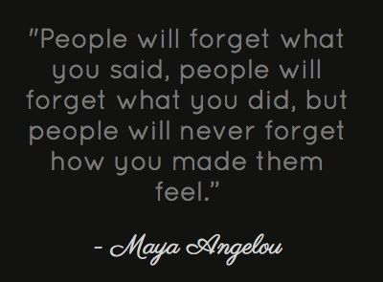

Slide 30
Thank you!
DIAZ DIXON, MA
Performance Driven Consulting

